Slide 1
college.leap
Micah Andres

Slide 2
What is college.leap? What is the purpose of the application?
The motivation of the application was to create a “one-stop shop” for high-school students to find a targeted college and prepare the student with sufficient amount of resources to make the student a competitive applicant for that particular university.
Clarify: Target Audience:
High-school students in the transition to a college/university environment (Hence the name: college.leap).
High-school counselors.

Slide 3
Main concept of college.leap
User signs up
Selects a college
User transitions to their member’s page (Dashboard) with their college data.
It has a checklist of what they must do in order to maintain on top of their application.
Contains a resource link that will help equip them to become more competitive applicants for that university.

Slide 4
Design Process
My father is a counselor back in Hawaii and I basically picked his brain and asked him what students are looking for.
From that conversation, what I took out of it was that students are looking for apps that help prepare them for college.
Utilizing my experiences as well as interviewing others around I brainstormed ideas of how this “one-stop shop” will be useful for the student.
I aimed at two main categories:
(1) Pulling college information
Testing (SATs/ACTs), Finances and Admissions
(2) Resources and Preparation.

Slide 5

Wireframing
Once my idea was approved I used Adobe XD to begin wireframing the concept.

Slide 6
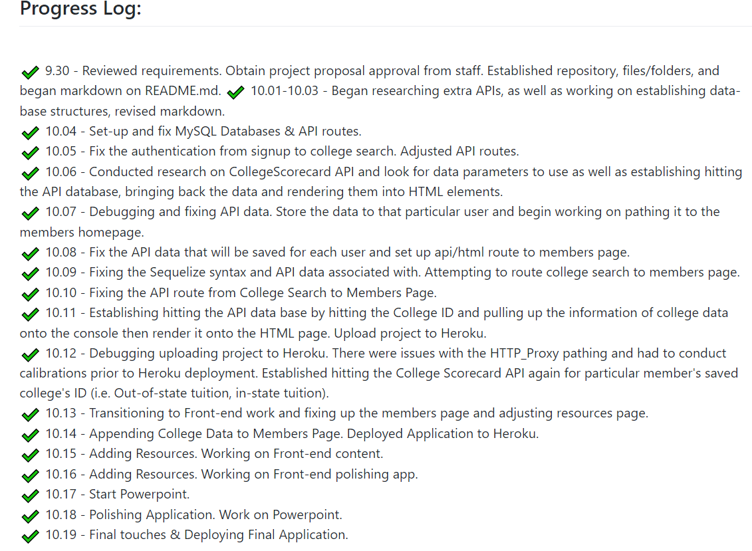
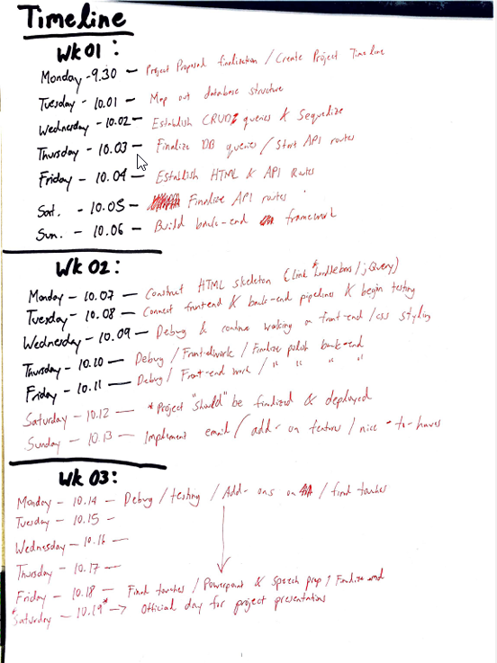
Creating a Project Timeline
Notes:
My progress log was pretty close to my original timeline, I think creating the api routes and html routes in association with the user authentication slowed down my progress.

Slide 7
Technologies Used
API: College ScoreCard (From the Department of Education)
ShareX
Adobe XD
Adobe After Effects

Slide 8
Demonstration

Slide 11
Future Development
Ideally my main focus for future development is to select more than one college for the student
Make the college.leap checklist save the user’s input when they log back in.
Add more additional resources (ebooks, more articles, videos etc).
Establish better security for the application.

